Slide 1
HACK BATTLERS
Sashidhar Reddy Gowra 12428313
Yashwant Kumar Palisetty 16202251
Ravi Kanth Devanaboyina 16198171
Anudeep Reddy Gujjula 16190413

Slide 2
Problem Statement
Building an Android application utilizing the YouTube API.
Application requires users to login with their email address and password.
Once logged in users will have a dashboard to search for videos, to look for most popular videos.
User can have “Remember me” option when logged in.
User should be able to log out of the application.

Slide 3
System Requirements
Software Requirements:
Operating system: Android
Version: Gingerbread (2.3) or advanced.
Tools used:
Visual Studio 2010.
Android Studio
Database – SQL Server.
ASP.NET Rest Services

Slide 4
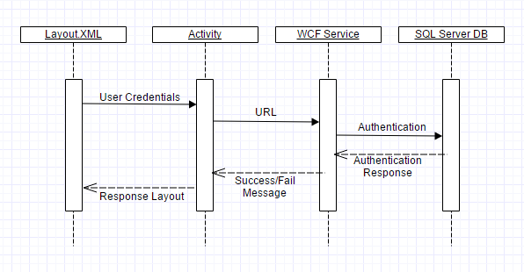
Sequence Diagram

Slide 5
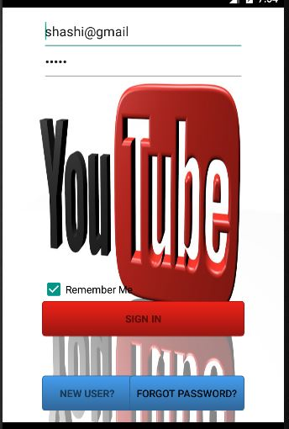
Features Implemented
LOGIN SCREEN
In the login screen users are required to login with their registered email id and password.
If the user is not yet registered he/she can sign up by clicking the “NEW USER” button at the bottom.
Users can click “Remember Me” to save their username and password.

Slide 6
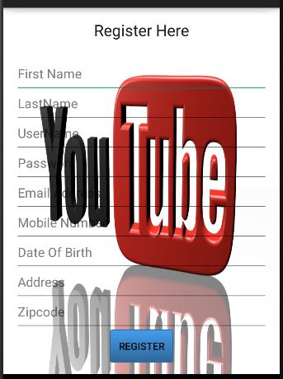
Features Implemented
REGISTRATION SCREEN
Users can register with the application by entering their details which are all mandatory.
Users will get registered once they click the “REGISTER” button and they will be directed to the login screen.

Slide 7

Features Implemented
RESET PASSWORD
Users will be directed to the “Reset Password” page when they click on the “FORGOT PASSWORD” button in the login page.
Here, the user can type his/her username and create a new password.
User password will be reset when he/she clicks on the “RESET PASSWORD” button.

Slide 8

Features Implemented
DASHBOARD PAGE
Once the users login with their credentials this dashboard screen appears.
Users can watch the videos by clicking on the “TOP VIDEOS” button or the “MOST VIEWED VIDEOS”.
User can search and watch a video of his choice by using the “SEARCH” button.
User can logout of his/her session any time by clicking the “LOGOUT” button.

Slide 9
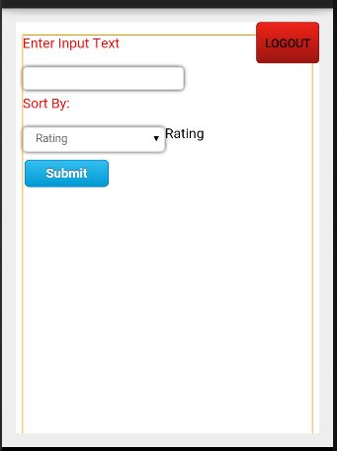
Features Implemented
SEARCH SCREEN
User can enter a search keyword to search for videos of his/her choice.
He/she can sort the videos by the categories using the “Sort By”.
By clicking the “Submit” button user can view the search results.
User can logout of his/her session any time by clicking the “LOGOUT” button.

Slide 10
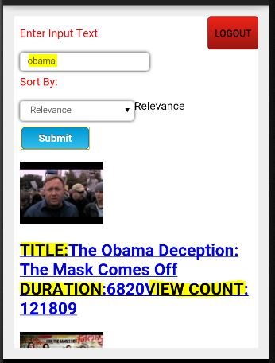
Features Implemented
SEARCH SCREEN
This screen shows the search results for the keyword “Obama”.
The resulting videos have the parameters like “Video Thmbnail”, “Title”, “Duration”, “View Count”.
User can logout of his/her session any time by clicking the “LOGOUT” button.

Slide 11
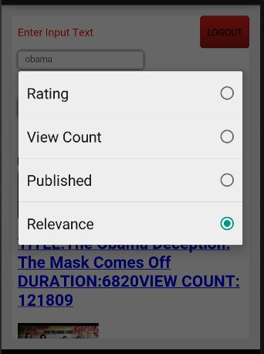
Features Implemented
SORTING
User can select the category using the “Sort By” button.
Videos appear according to the sorting options like “Rating”, “View Count”, “Published”, “Relevance”.
User can logout of his/her session any time by clicking the “LOGOUT” button.

Slide 12
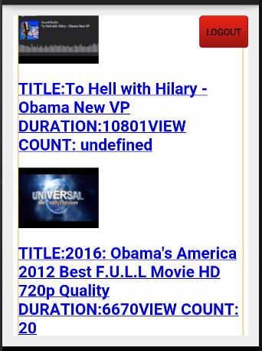
Features Implemented
Few of the video results are displayed.

Slide 13
THANK YOU

